Slide 1
CLOUD COMPUTING
PRESENTED BY
RAM VISHNU BHUMBAR

Slide 2
WELCOME TO WORLD OF CLOUD COMPUTING

Slide 3
WHAT IS CLOUD COMPUTING
CLOUD COMPUTING IS THE DELIVERY OF COMPUTING SERVICES OVER THE INTERNET

Slide 4
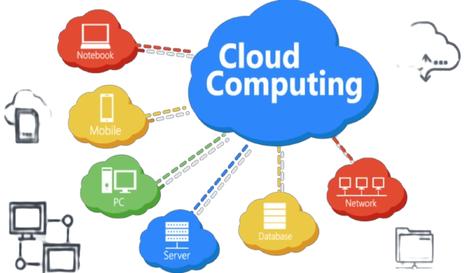

Slide 5
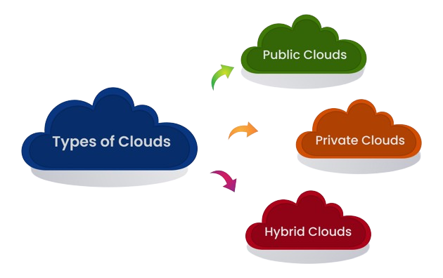

Slide 6
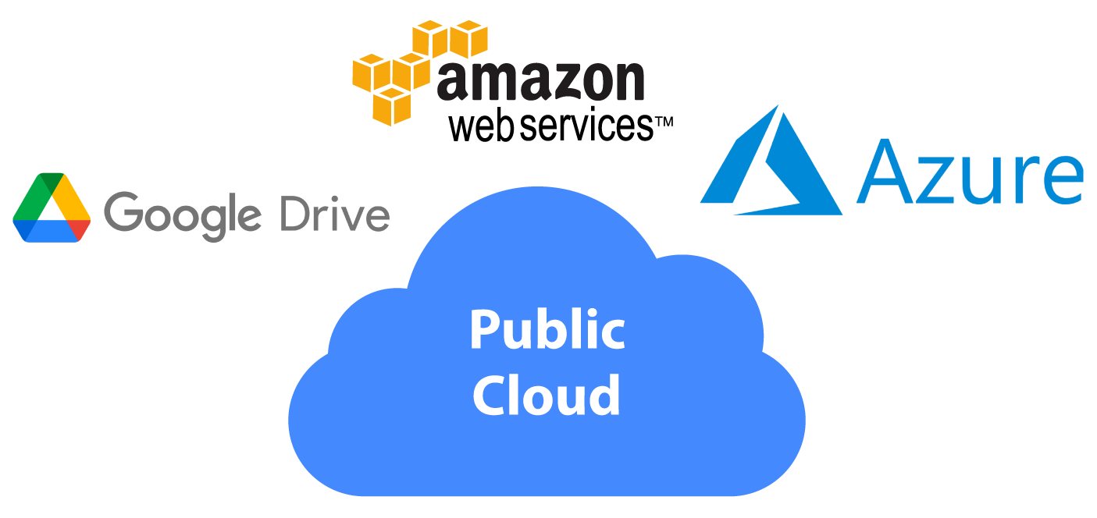
PUBLIC CLOUD
THE PUBLIC CLOUD IS DEFINED AS COMPUTING SERVICES OFFERED BY THIRD-PARTY PROVIDERS OVER THE PUBLIC INTERNET

Slide 7
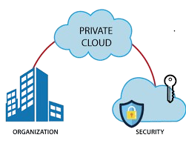
PRIVATE CLOUD
PRIVATE CLOUD ASLO KNOWN AS AN INTERNAL CLOUD OR COPORATGE CLOUD IS A CLOUD COMPUTING ENVIRONMENT IN WHICH ALL HARDWARE AND SOFTWARE RESOURCES ARE DEDICATED EXCLUSIVELY TO A SINGLE CUSTOMER.
ORGANIZATION
SECURITY

Slide 8
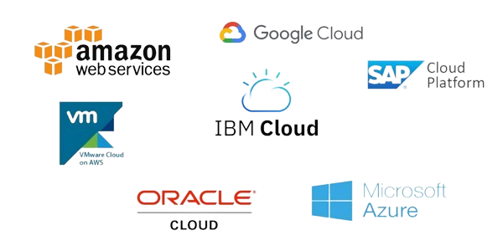
HYBRID CLOUD
A HYBRID CLOUD IS MIXEXD COMPUTING ENVIRONMENT THAT MEANS IT IS A COMBINATION OF PUBLIC CLOUDS AND PRIVATE CLOUDS

Slide 9
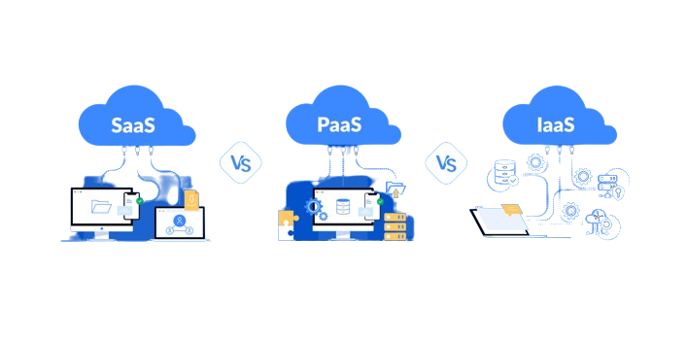
TYPES OF LAYERS IN CLOUD COMPUTING

Slide 10
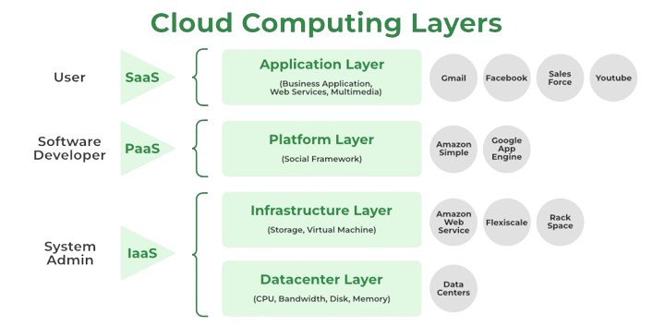

Slide 11
SOFTWARE AS A SERVICE
SAAS STANDS FOR A SOFTWARE AS A SERVICE
SAAS IS THE LAYER OF THE CLOUD THAT YOU’RE LIKELY MOST FAMILIAR WITH. IF YOU GO TO A WEB PAGE AND LOG IN TO ACCESS A TOOL OR SERVICE, YOU ARE USING SAAS.

Slide 12
PLATFORM AS A SERVICE
PASS STAND FOR PLATFORM AS A SERVICE
PASS IS A COMPLETE CLOUD ENVIRONMENT THAT INCLUDES EVERYTHING DEVELOPERS NEED TO BUILD,RUN, AND MANAGE APPLICATION .

Slide 13
INFRASTRUCTURE AS A SERVICE
IAAS STAND FOR INFRASTRUCTURE AS A SERVICE
INFRASTRUCTURE AS A SERVICE (IAAS) IS A TYPE OF CLOUD COMPUTING SERVICE THAT OFFERS ESSENTIAL COMPUTE, STORAGE, AND NETWORKING RESOURCES ON A PAY-AS-YOU-GO BASIS.

Slide 14
PURPOSE OF CLOUD COMPUTING
Cloud Storage enables organizations to store, access, and maintain data so that they do not need to own and operate their own data centers, moving expenses from a capital expenditure model to operational. Cloud Storage is scalable, allowing organizations to expand or reduce their data footprint depending on need.

Slide 15


